Slide 1
Analysis of Glassdoor Reviews for competitors – ICE ( Intercontinental Exchange)

Slide 2
Agenda
Executive Summary
Overall word cloud for Pros and Cons
What people liked (based on 5 star ratings)
What people liked (based on 4 star ratings)
What people liked (based on 3 star ratings)

Slide 3
Executive Summary
Objectives
Scrapping Glassdoor reviews for competitors given by their employees.
Analyzing reviews of competitors
Identify hidden patterns in data about employee engagement.
Key Observations
We scrapped close to 98% of reviews.
Total 330 reviews were analyzed.

Slide 4
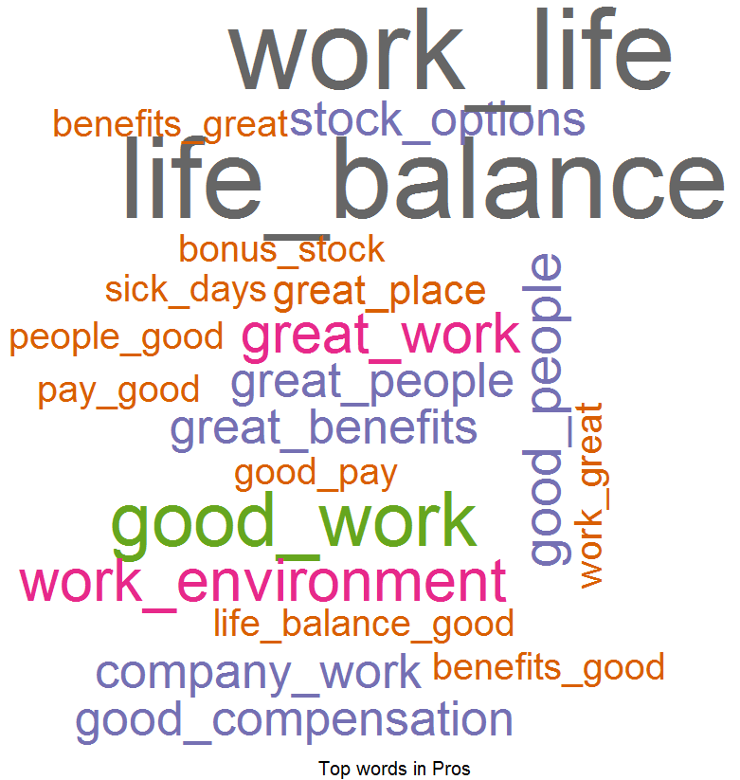
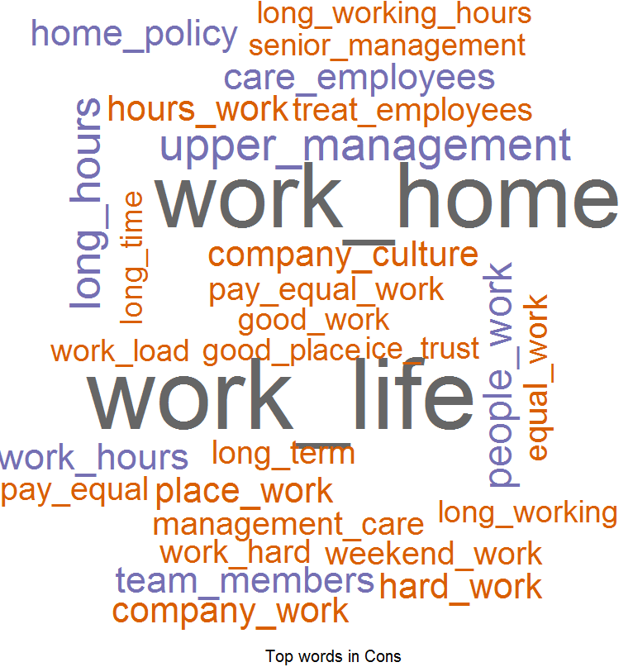
Overall Word Cloud for Pros and Cons
Word Cloud for Pros
Word Cloud for Cons
Good Words List –
Work life balance
Good benefits
Good work
Fast passed work environment
Good people
Stock options
Word List which people don’t like –
Work life balance
Work from home policy
Upper management
Long hours
Working hours
Career growth
Care for employees
Hard work

Slide 5
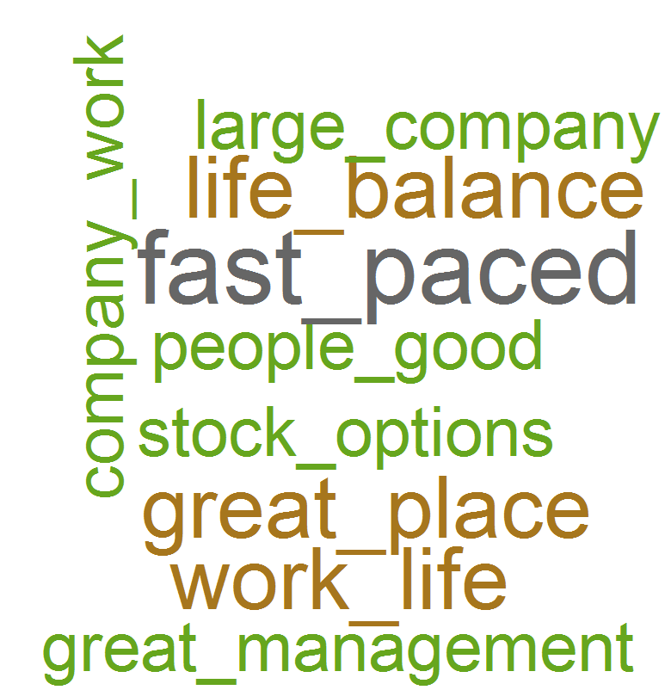
What people liked (based on 5 star ratings)
Word Cloud for Pros
Good Words List –
Fast paced
Work life balance
Great benefits
Great Place to work
Growth opportunities
Smart people
Great management
Stock options
Interesting projects
Great company

Slide 6
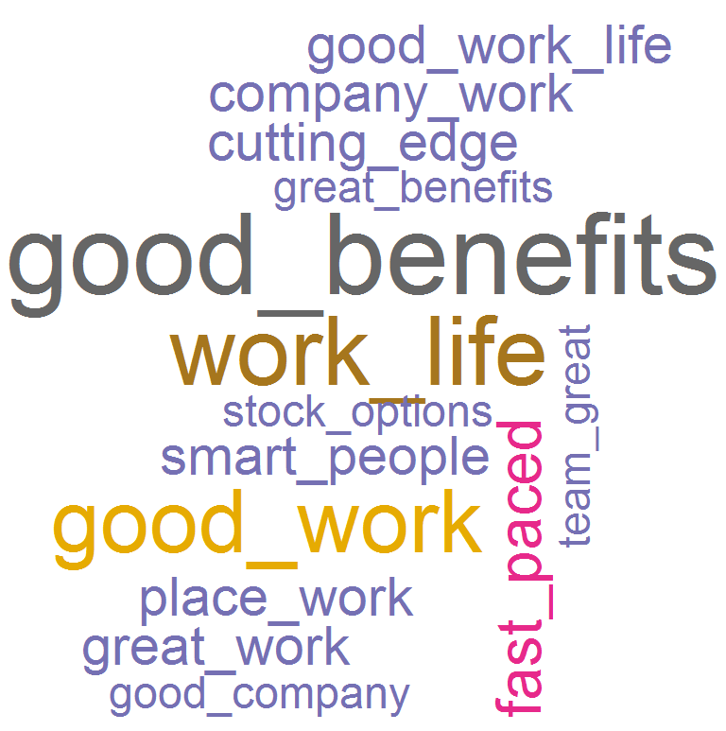
What people liked (based on 4 star ratings)
Word Cloud for Pros
Good Words List –
Good Benefits
Work life balance
Good work
Fast paced
Work environment
Cutting edge technology
Smart people
Stock options

Slide 7
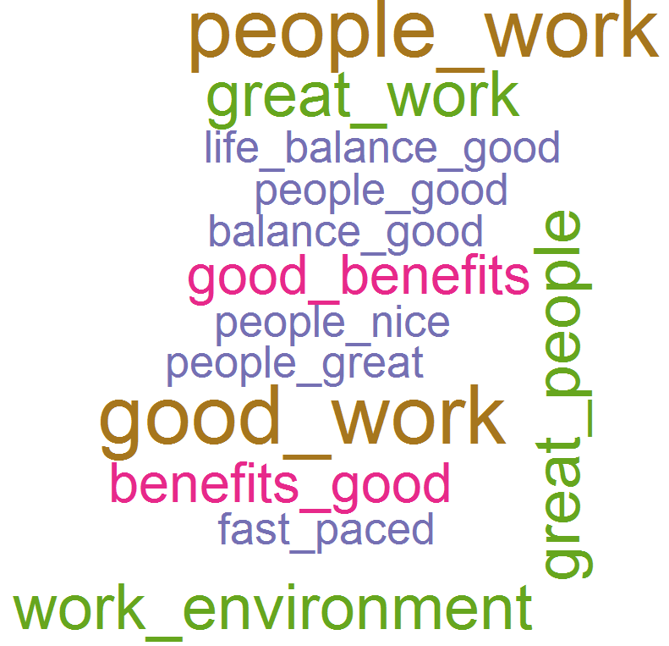
What people liked (based on 3 star ratings)
Word Cloud for Pros
Good Words List –
Work life balance
People and work
Good people
Good work
Work environment
Good benefits
Fast paced
Great work
Smart people
Flexible work
Benefits and vacations

